Slide 1
REVENUE INCREASE FOR AIRBNB
By – Subhransu Pradhan
K Rohit

Slide 2
DATASET DESCRIPTION
Dataset is given in .csv format.
Dataset contains 48895 rows and 16 columns.
There is some null values in the dataset , i.e , in columns like ‘name’ , ‘host_name’ , ‘last_review’ and ‘reviews_per_month’.

Slide 3
Steps used in the Case Study
Data Cleaning:
1.Handle the “Select” level that is present in many of the categorical variables.
2.Drop columns that are having high percentage of missing values. Check all the columns before dropping them.
3.Check the number of unique categories in each categorical column. Here you may need to do something.
4.For the columns with less percentage of missing, use some imputation technique.
5.Finally check the percentage of rows retained in data cleaning process.

Slide 4
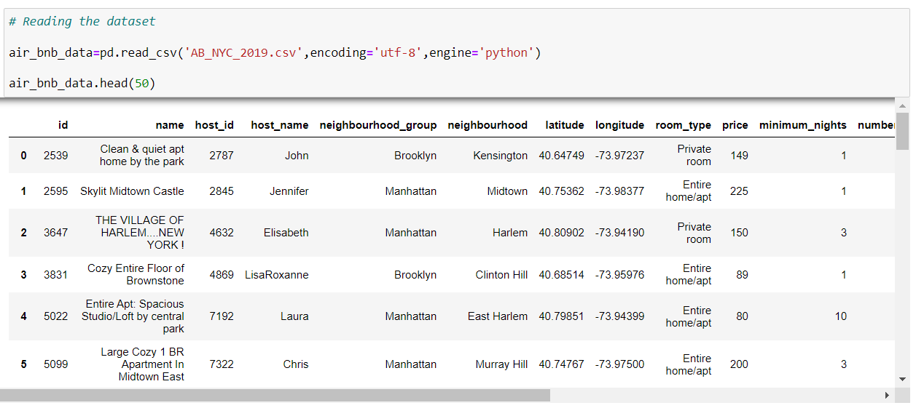
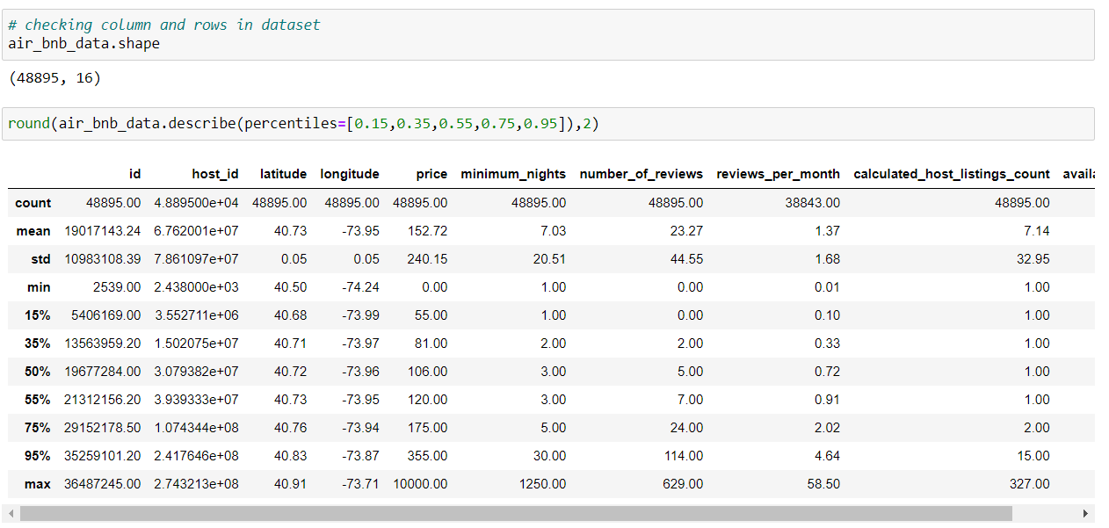

Slide 5
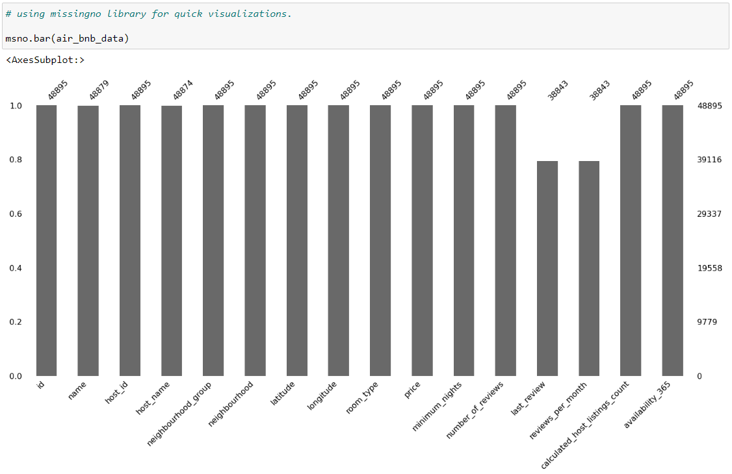
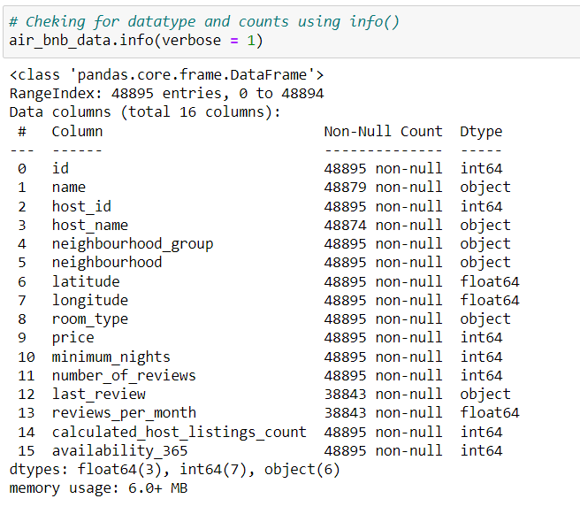
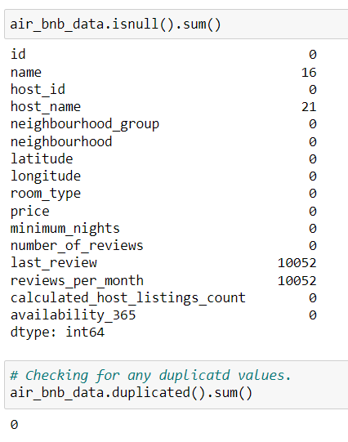

Slide 6
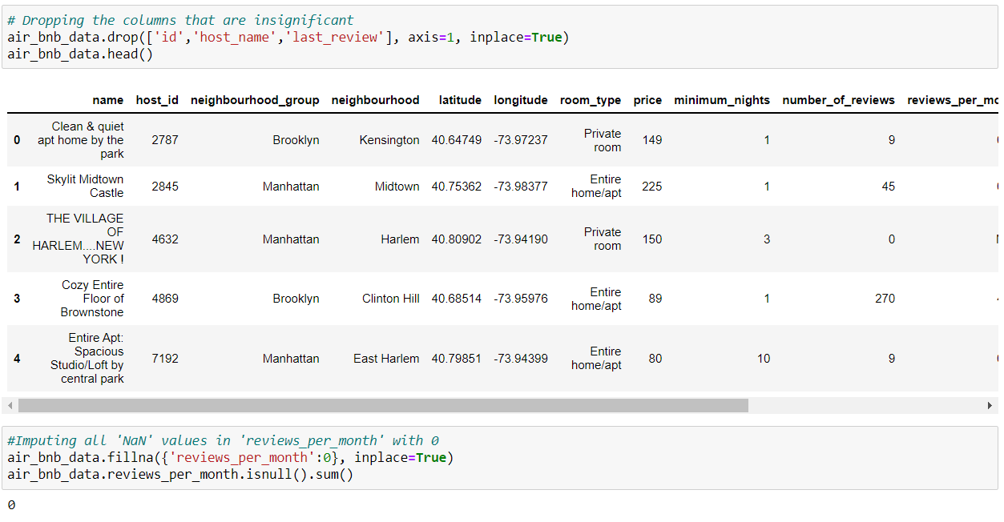
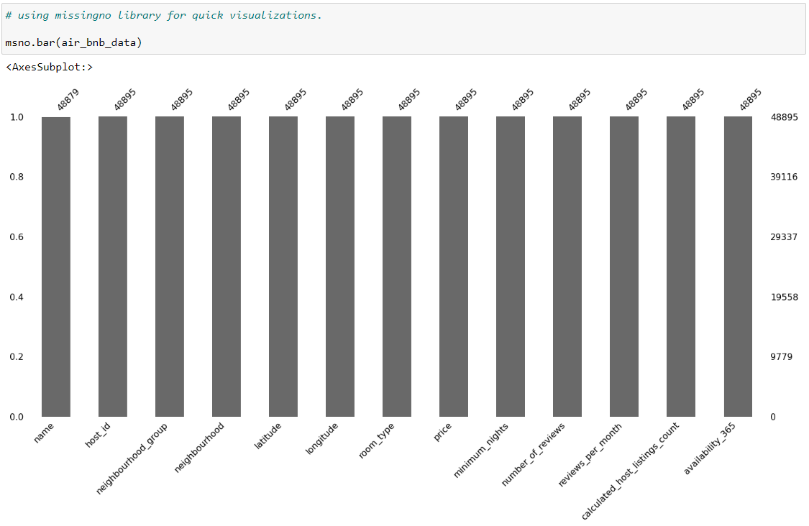

Slide 7
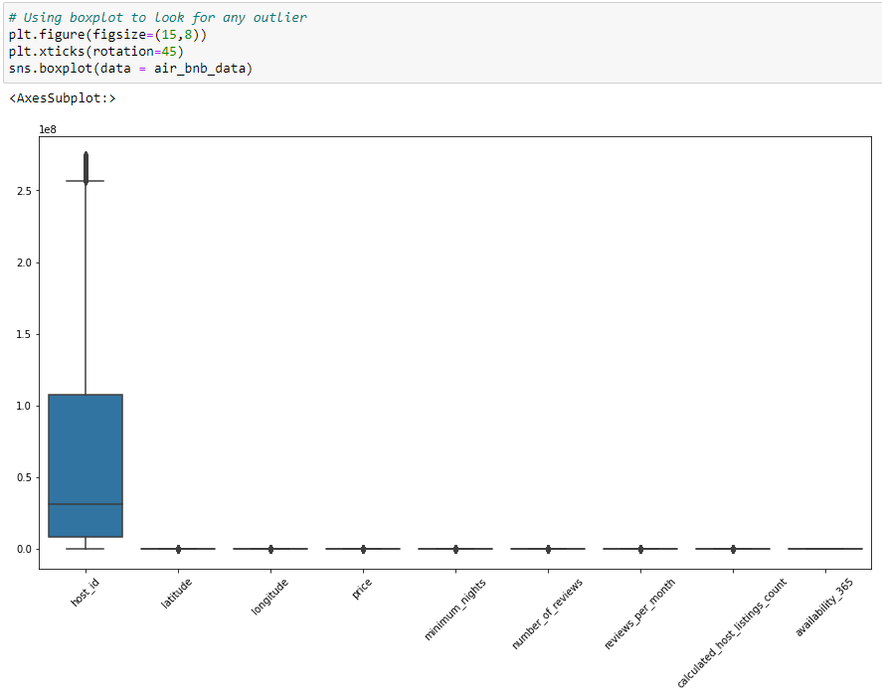
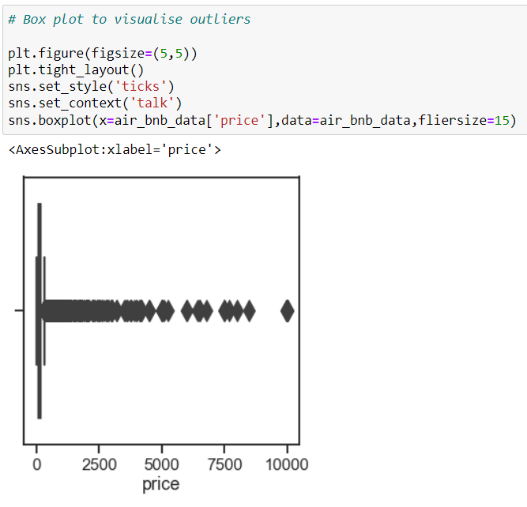

Slide 8
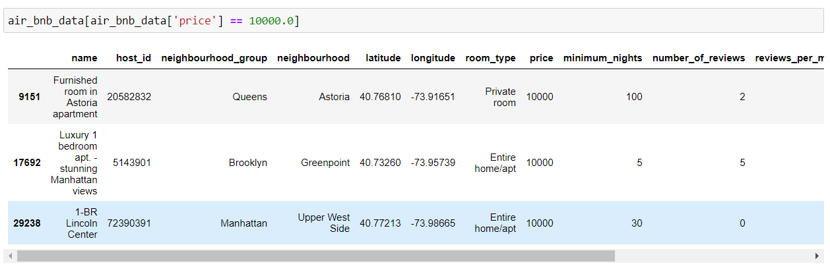
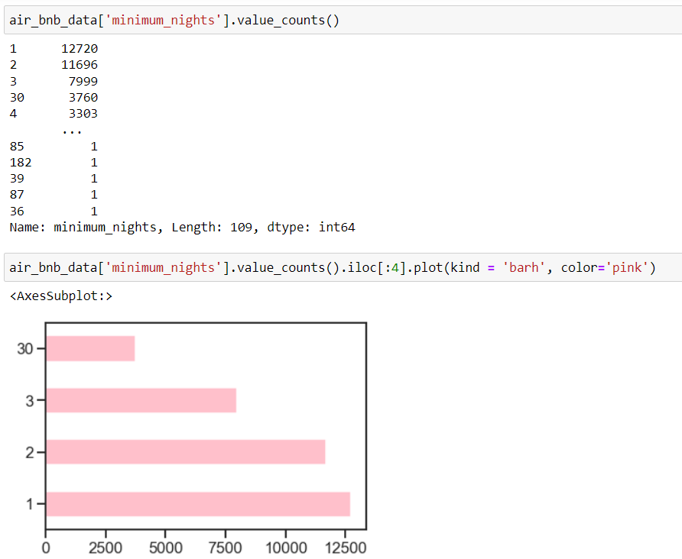
We have 3 airbnbs with 10000 per night luxury stay, one private room and 2 home stay.
Almost 3.7k stayed upto a month.

Slide 9
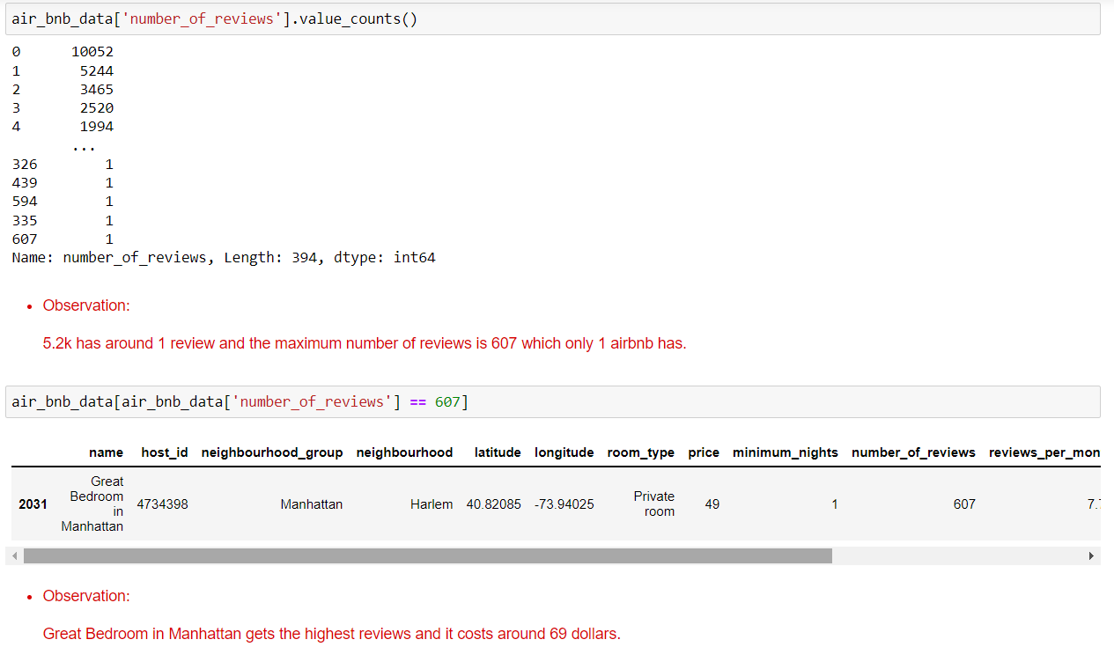
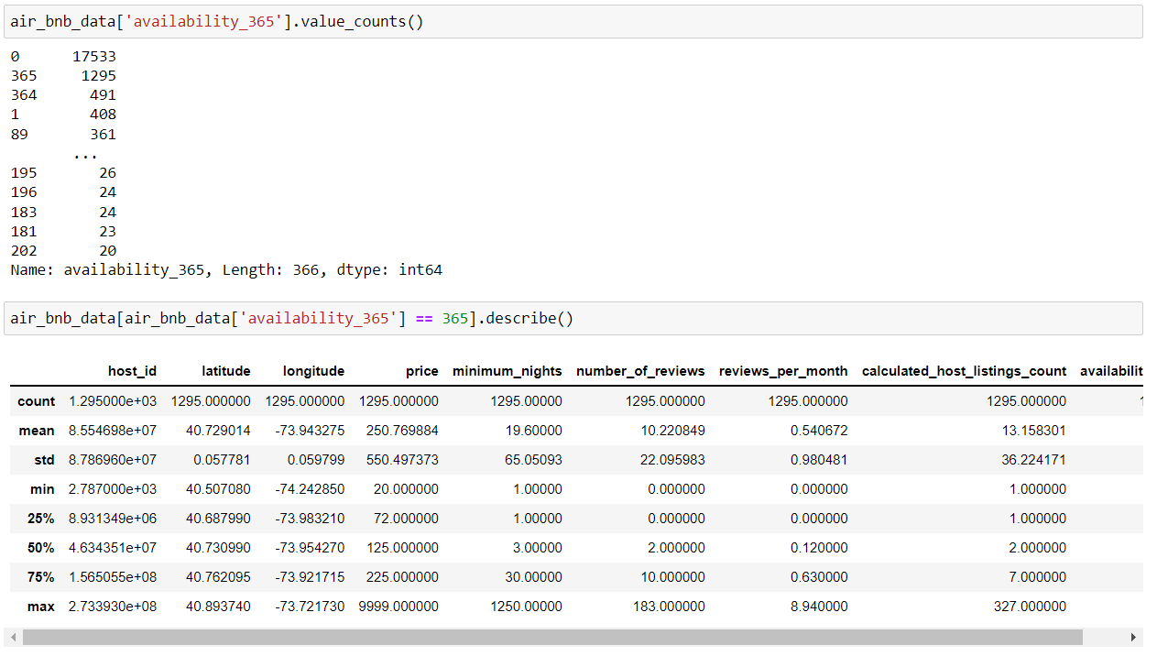
For a year of availablity airbnb costs around 10k dollars with average of 250 dollars.

Slide 10
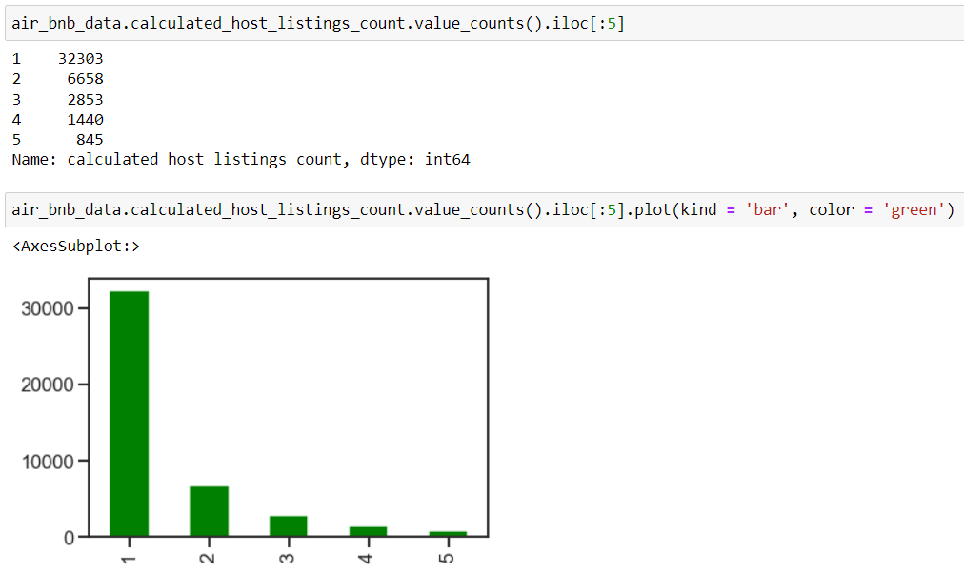
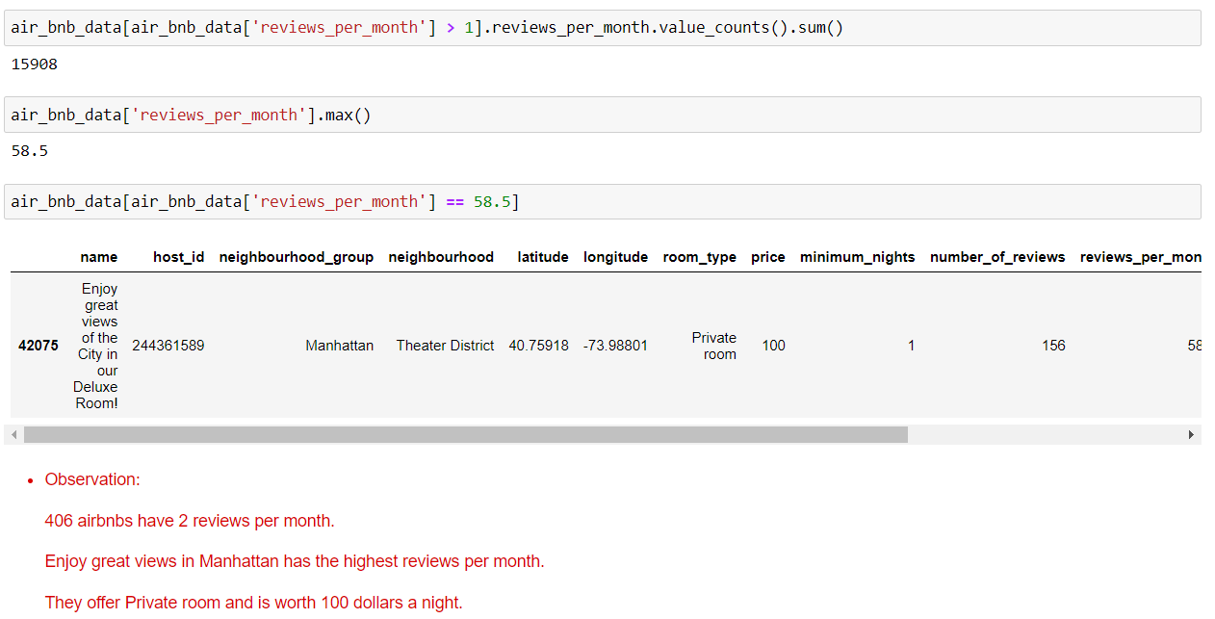
Listing was used mostly once 32.3k times.

Slide 11
CONCLUSION
This Airbnb ('AB_NYC_2019') dataset for the 2019 year appeared to be a very rich dataset with a variety of columns that allowed us to do deep data exploration on each significant column presented. First, we have found hosts that take good advantage of the Airbnb platform and provide the most listings; we found that our top host has 327 listings. After that, we proceeded with analyzing boroughs and neighborhood listing densities and what areas were more popular than others. Next, we put good use of our latitude and longitude columns and used them to create a geographical heatmap color-coded by the price of listings. Further, we came back to the first column with name strings and had to do a bit more coding to parse each title and analyze existing trends on how listings are named as well as what was the count for the most used words by hosts. Lastly, we found the most reviewed listings and analyzed some additional attributes. For our data exploration purposes, it also would be nice to have a couple of additional features, such as positive and negative numeric (0-5 stars) reviews or 0-5 star average reviews for each listing; the addition of these features would help to determine the best-reviewed hosts for NYC along with 'number_of_review' column that is provided. Overall, we discovered a very good number of interesting relationships between features and explained each step of the process. This data analytics is very much mimicked on a higher level on the Airbnb Data/Machine Learning team for better business decisions, control over the platform, marketing initiatives, implementation of new features, and much more.

Slide 12
THANK YOU

